Slide 1
Enhancing Driver Safety with FER Technology Integrating Facial Emotion Recognition in Automotive Systems
Supervisor: Floris De Feyter
Iñigo Aduna
Ahmad BeigRezaei
Minoo Safaeikouchaksaraei
Master of Artificial Intelligence in Business and Industry
Academic year 2023 – 2024
Notes:
Good afternoon, everyone. Today, we are here to present our project titled "Enhancing Driver Safety with Facial Emotion Recognition Technology”.
This project aims to explore the importance of emotion detection in vehicles, to enhance road safety and improve the overall driving experience.

Slide 2

Link To Github:
https://github.com/AhmadBeigRezaei/VisionGuard-CV/
Notes:
Let me introduce the members of our group team:
Minoo: Coming from an Industrial Engineering and Information Systems background.

Slide 3
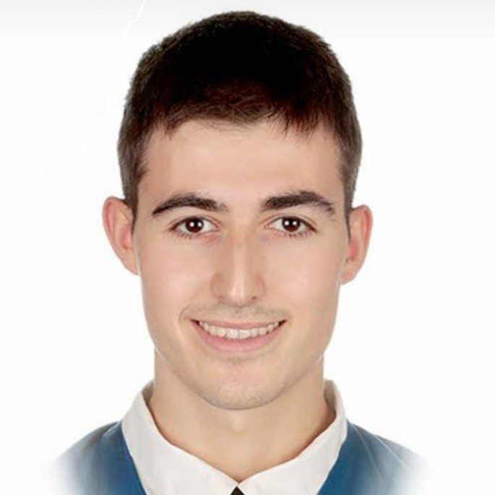
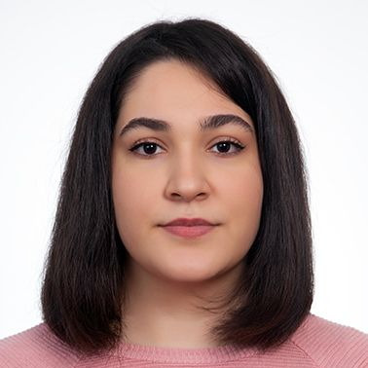
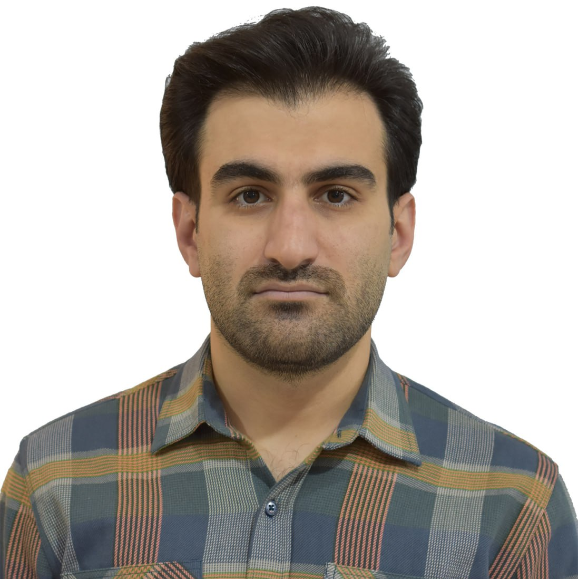
Team Members:
Iñigo Aduna Alonso
Physics & Electronics Engineering UPV/EHU
Minoo Safaeikouchaksaraei
Industrial Engineering, Information Systems
Ahmad BeigRezaei
MBA, Power Engineering
Notes:
Let me introduce the members of our group team:
Minoo: Coming from an Industrial Engineering and Information Systems background.

Slide 4

Group Members:
Iñigo Aduna Alonso
Physics & Electronics Engineering UPV/EHU
Minoo Safaeikouchaksaraei
Industrial Engineering, Information Systems
Ahmad BeigRezaei
MBA, Power Engineering
Notes:
Ahmad: With an expertise in MBA and Power Engineering.

Slide 5

Group Members:
Iñigo Aduna Alonso
Physics & Electronics Engineering UPV/EHU
Minoo Safaeikouchaksaraei
Industrial Engineering, Information Systems
Ahmad BeigRezaei
MBA, Power Engineering
Notes:
And me, Iñigo: With a Double bachelor’s in physics and Electronics Engineering.

Slide 6



Business Understanding
INTERACTION
SAFETY
PRIVACY & SECURITY
Notes:
Here are the key reasons why this technology is important:
1. Safety:
Detecting driver emotions is crucial to prevent accidents. For instance, if the system notices emotions like anger, fear, or sadness, it can advise the driver to take a break or do something calming.
2. Interaction:
It also enhances the communication between the driver and vehicle leading to a more personalised driving experience. For instance, if the system senses that the driver is happy, it can provide positive reinforcement by suggesting points of interest along the way.
3. Privacy:
However, continuous monitoring raises concerns about privacy and data security. In this approach we apply blurring on inference to minimize intrusiveness and study the model’s performance with respect to the anonymization level.

Slide 7


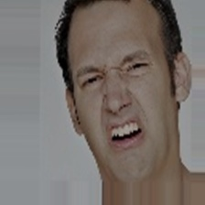

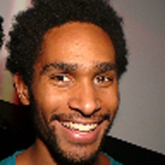



Data Understanding
Anger
Contempt
Disgust
Fear
Happy
Neutral
Sad
Surprise
Vision+
Dataset Splitting (Train/Test/Validation)
Data Class Balancing (Dataset Augmentation)
Data Channels (Grayscale → RGB)
Image Scaling + File Formatting
CK+
FER-2013
AffectNet
Notes:
With regards to the Data Understanding part:
1.- Dataset Merging
We have merged three datasets: CK+, FER-2013, and AffectNet. The reason for merging these datasets is to create a more diverse and comprehensive dataset that improves the model's generalization across different demographics and scenarios.

Slide 8
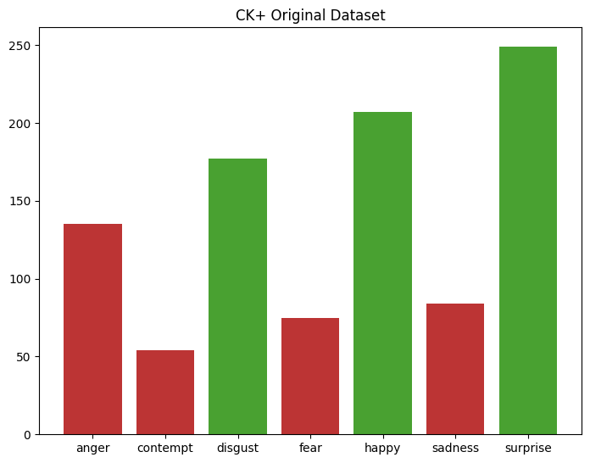
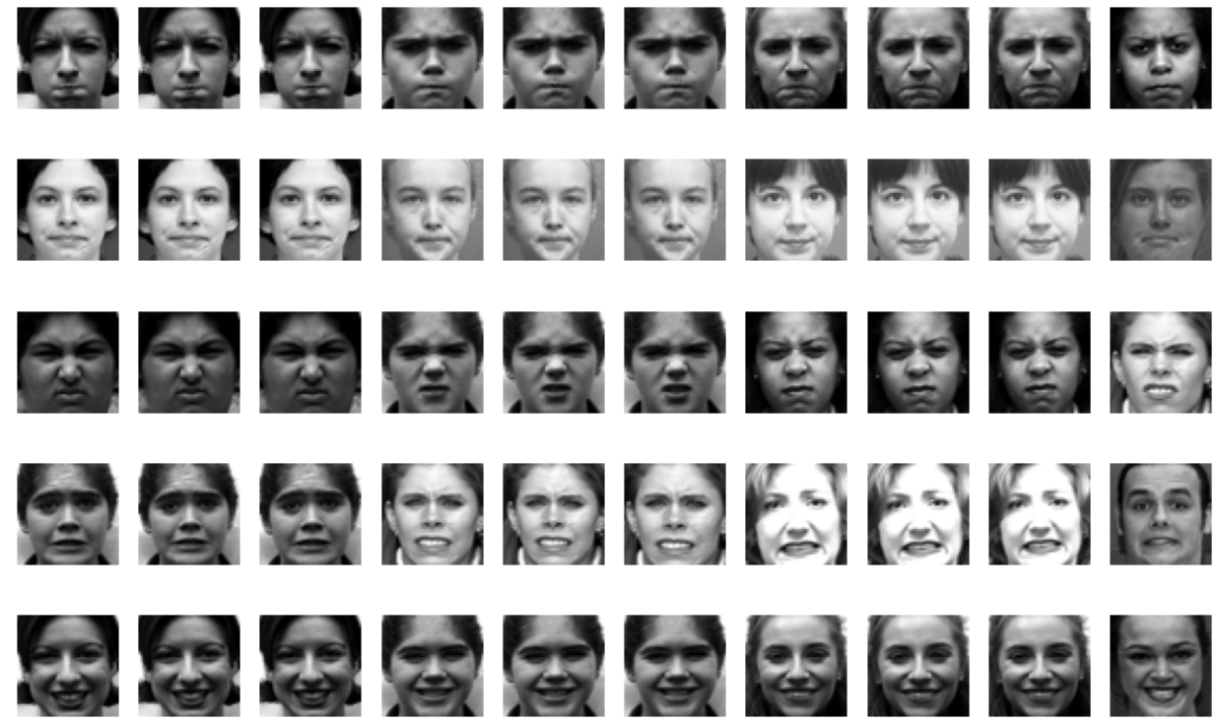
Data Understanding
CK+
Classes: 7
Datapoints: 981
Img. Size: 48x48
Channels: 2
Notes:
That includes 981 video sequences capturing subjects transitioning from neutral to peak expressions.

Slide 9
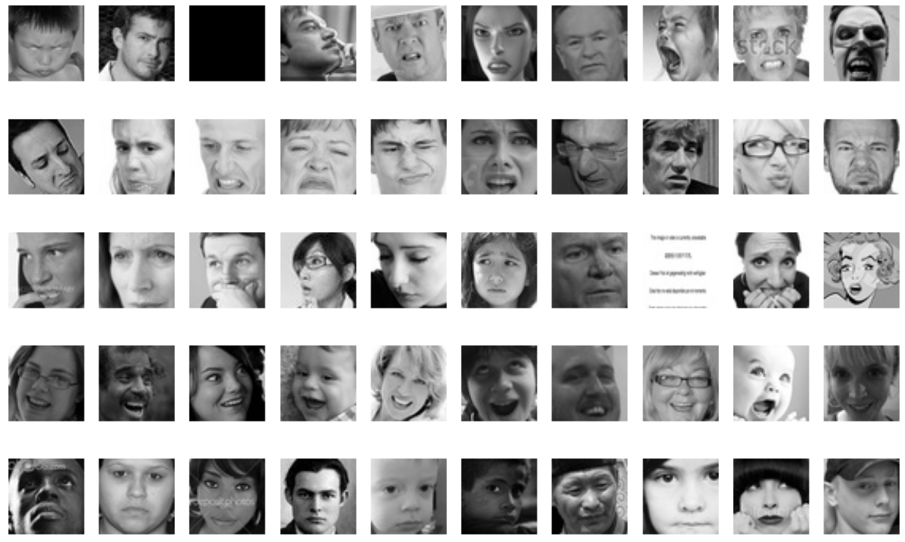
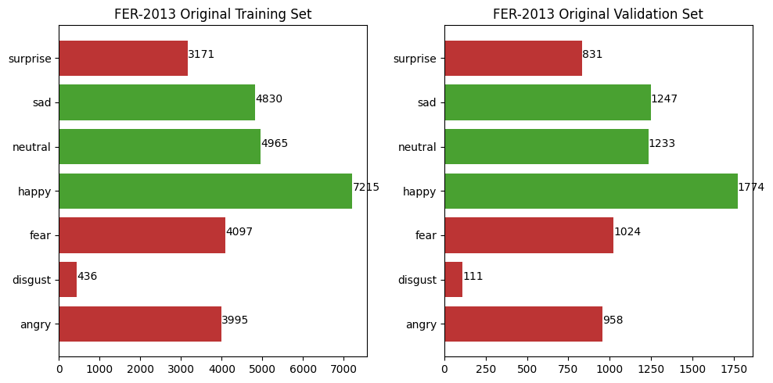
Data Understanding
FER 2013
FER-2013
Classes: 7
Datapoints: 35887
Img. Size: 48X48
Channels: 2
Notes:
Comprising around 35,000 Grayscale facial images, standardized to 48x48 pixels, covering seven primary emotions

Slide 10
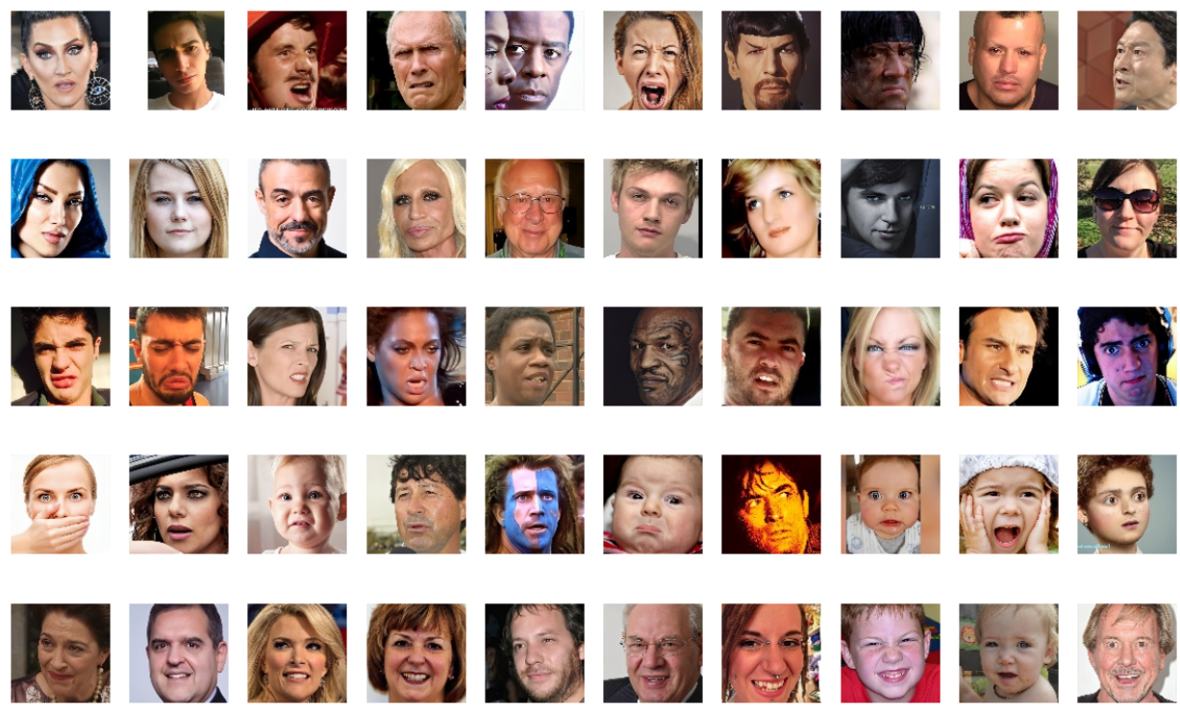
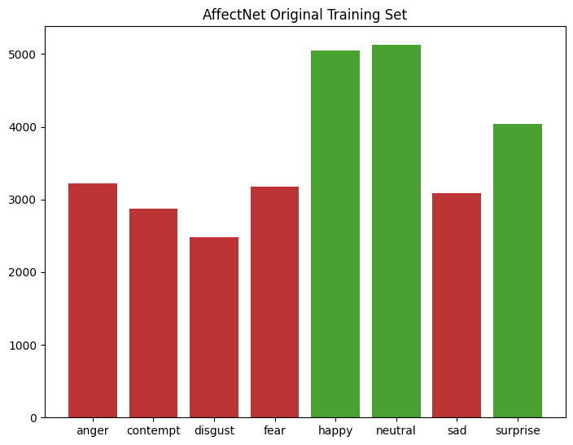
Data Understanding
AffectNet
Classes: 8
Datapoints: 29042
Img. Size: 96x96
Channels: 3
Notes:
AffectNet contains 29,000 images classified into eight emotion categories.

Slide 11
Data Understanding
Anger
Contempt
Disgust
Fear
Happy
Neutral
Sad
Surprise
Vision+
Dataset Splitting (Train/Test/Validation)
Data Class Balancing (Dataset Augmentation)
Data Channels (Grayscale → RGB)
Image Scaling + File Formatting
CK+
FER-2013
AffectNet
Notes:
To prepare the data for our model, we convert grayscale images to RGB by copying the content into all three channels. We also rescale all images to 224x224 pixels, matching the input size of the ImageNet pre-trained models.

Slide 12
Data Understanding
Anger
Contempt
Disgust
Fear
Happy
Neutral
Sad
Surprise
Vision+
Dataset Splitting (Train/Test/Validation)
Data Class Balancing (Dataset Augmentation)
Data Channels (Grayscale → RGB)
Image Scaling + File Formatting
CK+
FER-2013
AffectNet
Notes:
Balanced data classes are crucial to prevent bias in the model's predictions. (When classes are imbalanced, the model tends to perform poorly on underrepresented classes, leading to inaccurate and unfair results.)

Slide 13
Data Understanding
Anger
Contempt
Disgust
Fear
Happy
Neutral
Sad
Surprise
Vision+
Dataset Splitting (Train/Test/Validation)
Data Class Balancing (Dataset Augmentation)
Data Channels (Grayscale → RGB)
Image Scaling + File Formatting
CK+
FER-2013
AffectNet
Notes:
Balanced data classes are crucial to prevent bias in the model's predictions. (When classes are imbalanced, the model tends to perform poorly on underrepresented classes, leading to inaccurate and unfair results.)

Slide 14
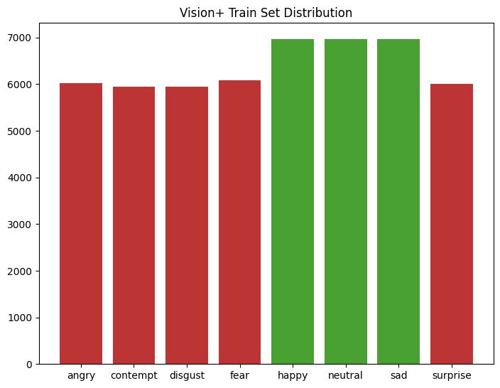
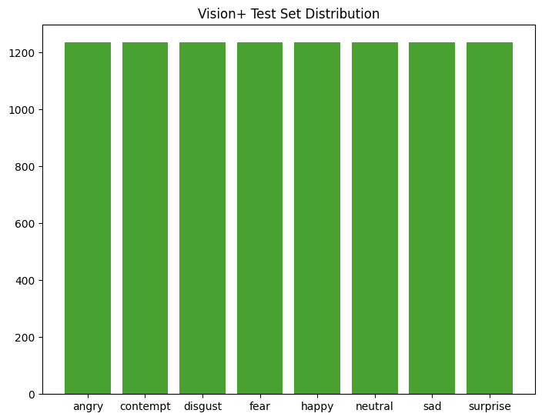
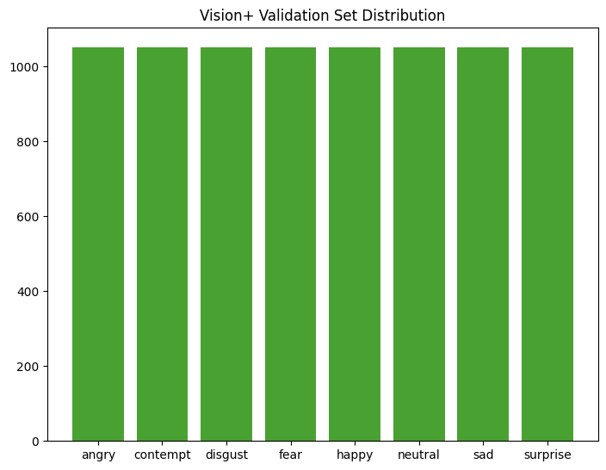
Data Understanding
Anger
Contempt
Disgust
Fear
Happy
Neutral
Sad
Surprise
Vision+
Classes: 8
Datapoints: 69202
Img. Size: 224x224
Channels: 3
Notes:
Our final dataset is balanced and capable of detecting eight distinct classes of emotions.
Now, I'll hand it over to my colleague, Ahmad.

Slide 15
Our Approach
Training a model to indentify the face of the driver and detect their facial expression.
Because of privacy concerns, we decided to blur the images of the driver
To do this, we first setuped a base model to see the performance, and then applied different levels of Bluring to see on what threshold the faces are not recognizable yet the model performs good enough.

Slide 16
Our Approach
To setup the base model we First trained a baseline model on our dataset using transfer learning
Our Approach uses a face detection model to detect faces, then passes the face to the second model to detect the facial expressions.
Chosen Model: VGG16 Model to classify the emotions, and OpenCV’s Haar cascade to detect the faces.
The VGG16 Model was preloaded with weights based on ImageNetV1 and needs to be trained on our Dataset. First We add a classification layer to map the output vector to 128 and another one to map to our 8 classes output.

Slide 17
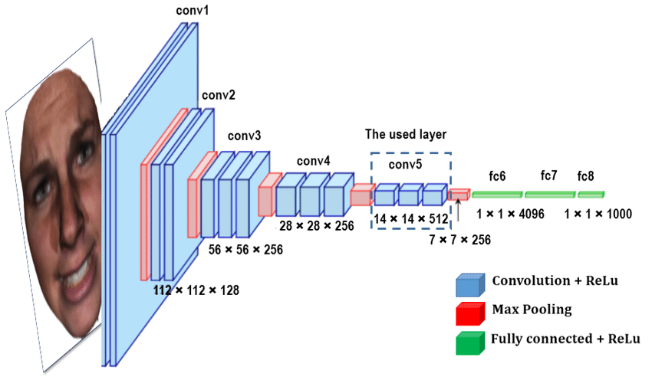
Model Architecture
Notes:
The VGG16 model is a convolutional neural network (CNN) that consists of a series of convolutional layers, followed by pooling layers, and finally, fully connected layers. In our modified version, you've added two extra fully connected layers to the classifier.

Slide 18
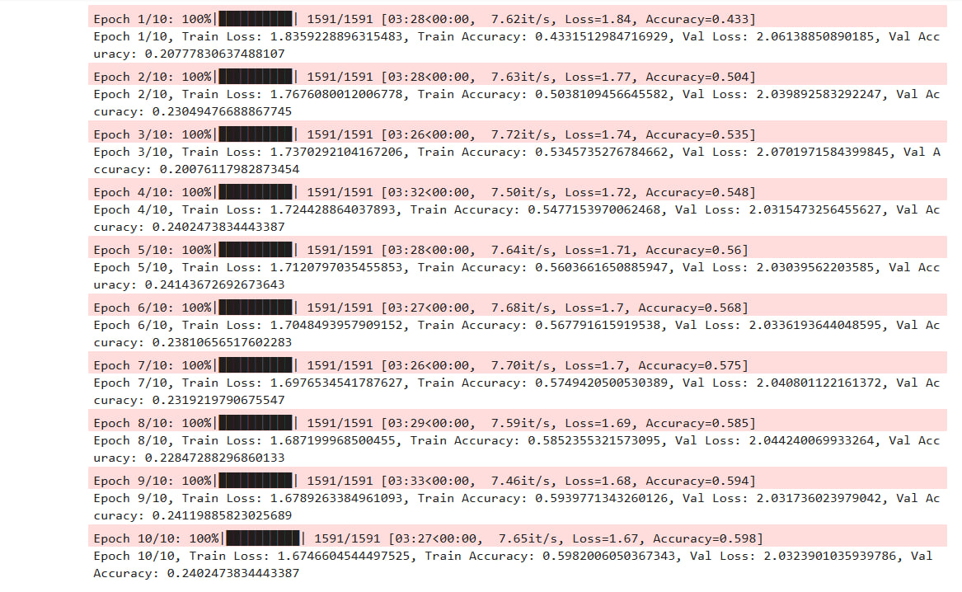
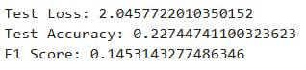
Our Approach
We used CrossEntropyLoss and Adam Optimizer with default learning rate of 0.001
The result for training this configuration on Vision+ Dataset with 10 epochs and batch size of 32 is as follows
LossFunction: CrossEntropyLoss
Optimizer: Adam, LearningRate: 0.001
Batch Size: 32, Epochs: 10

Slide 19
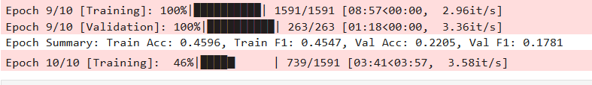
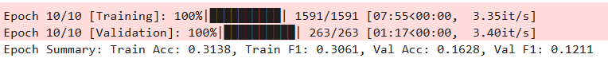
Our Approach
As it could be seen, the model was not performing well. Also each train was time consuming as our dataset was too big.
Then we tried different learning rates:
Learning Rate: 0.001
Learning Rate: 0.0001

Slide 20
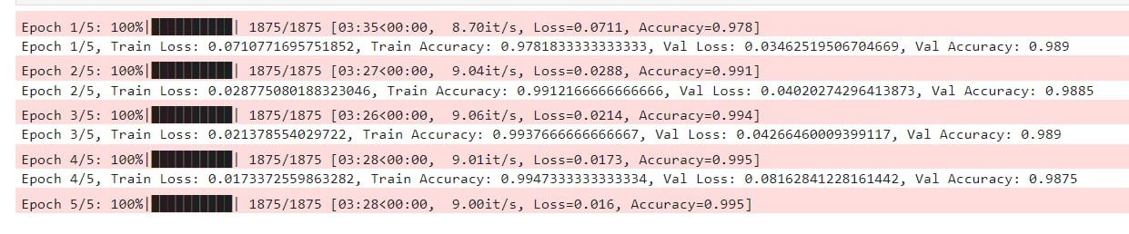
Testing of our Pipeline
To make sure our pipeline worked, we tested it on MNIST Dataset and the result was good and showed that the pipeline is working properly.
Therefore, we used a smaller part of our dataset and only considered using AffectNet.

Slide 21
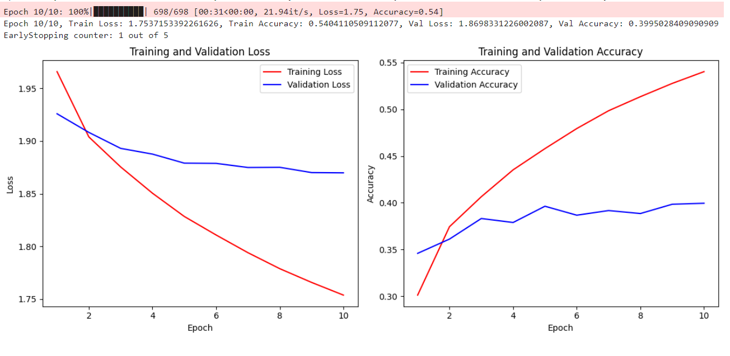
Model Performance on Affectnet
For improving the performance different learning rates applied and tested; Best performing learning rates were as
First layer = 0.00001 and the last layer = 0.0001 First including a SoftMax layer:

Slide 22
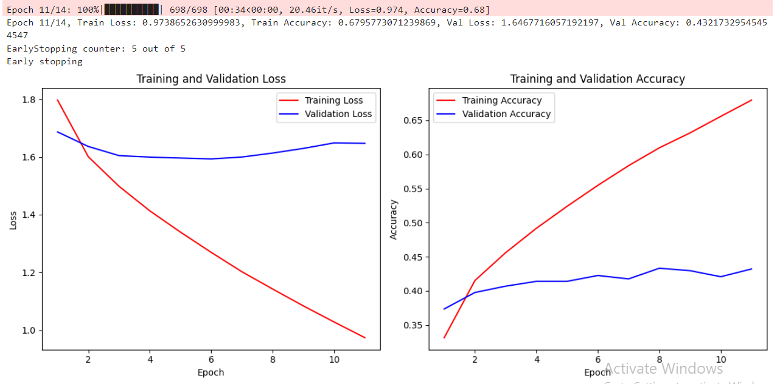
Model Performance on Affectnet
After Removing the Softmax layer:

Slide 23
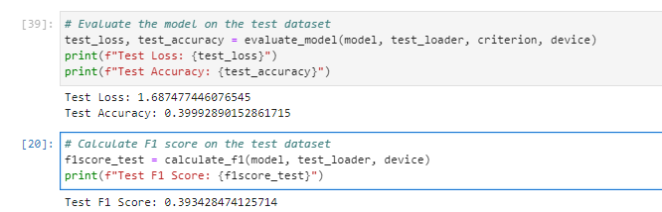
Model Performance on Affectnet
After Removing the Softmax layer:

Slide 24
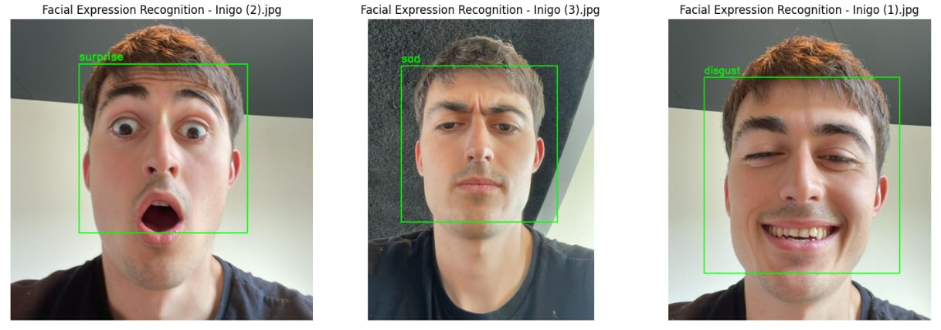
Model Performance on Affectnet
Sample examples:

Slide 25
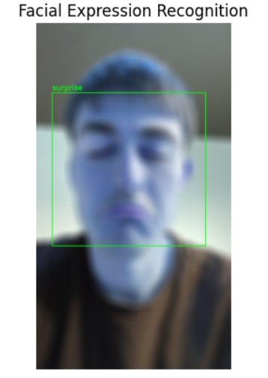
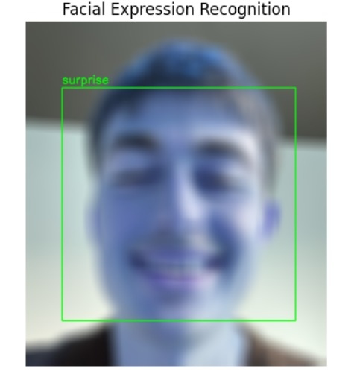
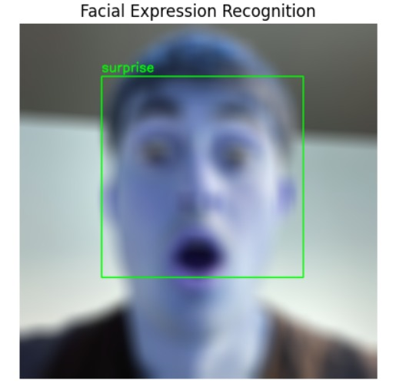
Model Performance on Affectnet
Sample examples blurring added:

Slide 26
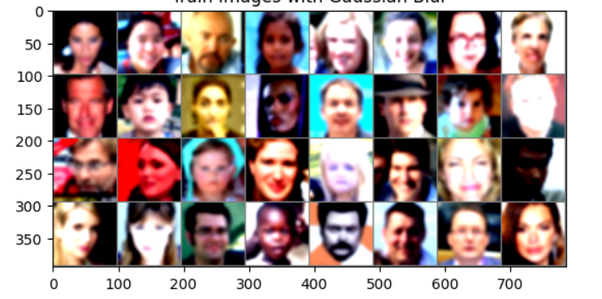
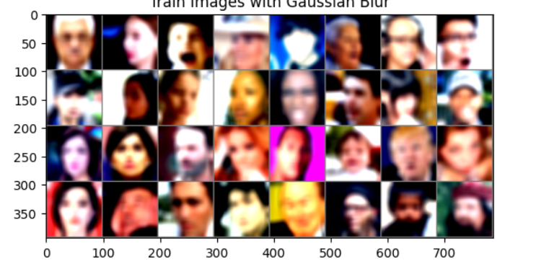
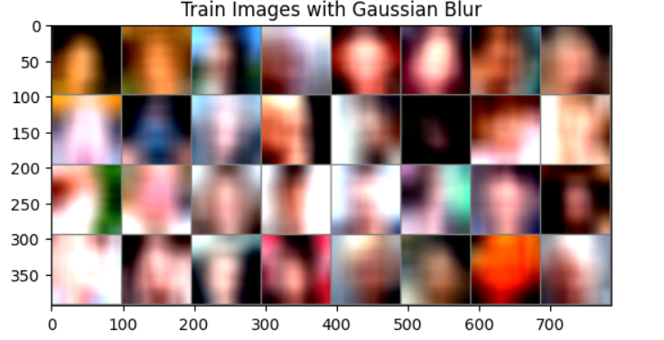
Blurring Effect
Level 1 Kernel size = 11 sigma = 3.0
Level 1 Kernel size = 15 sigma = 3.0
Level 1 Kernel size = 41 sigma = 30.0

Slide 27
Blurring Effect

Slide 28
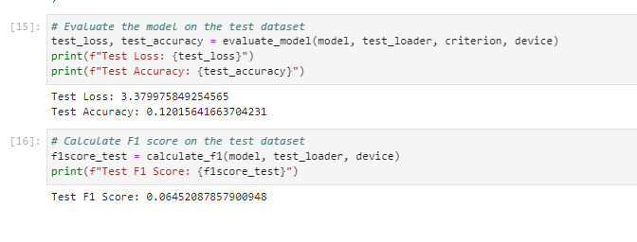
Most Intensive Blurring Effect

Slide 29
Last Approach: Binary Classification
Considering:
The model was not still performing good enough
The task of Facial Expression Recognition is hard, for example:
Different facial expression does not contain a lot of difference in the image
Distinguishing between close classes (Happy and Contempt)
Suprized class contain both happy and fear feelings.
We decided to simplify the task by making it a binary classification using 2 classes of possitive feeling and negative feeling. Resulting in AffNetBinary dataset.
“positive” = [“contempt”, “happy”, “neutral”]
“negative” = [“surprize”,”sad”,”fear”,”anger”,”disgust”]

Slide 30
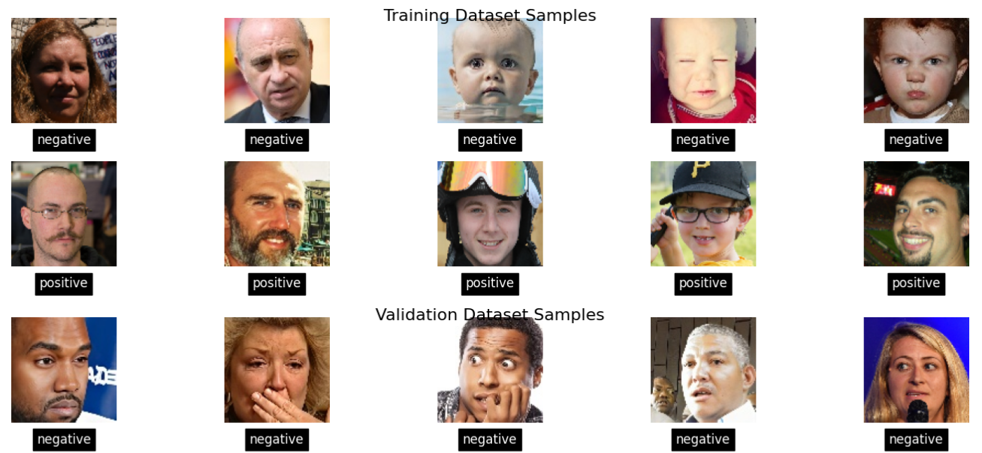
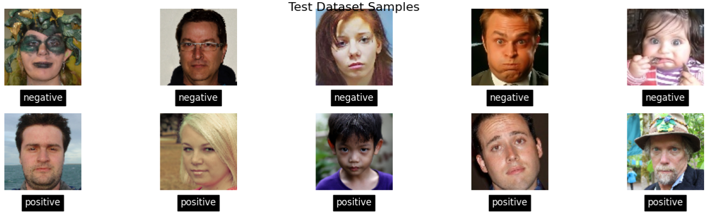
Last Approach: Binary Classification
Visualization of the train, validation, and test dataset

Slide 31
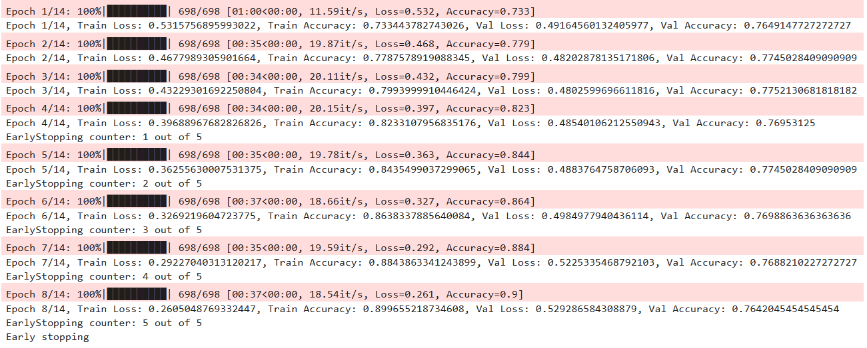
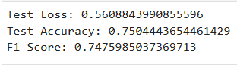
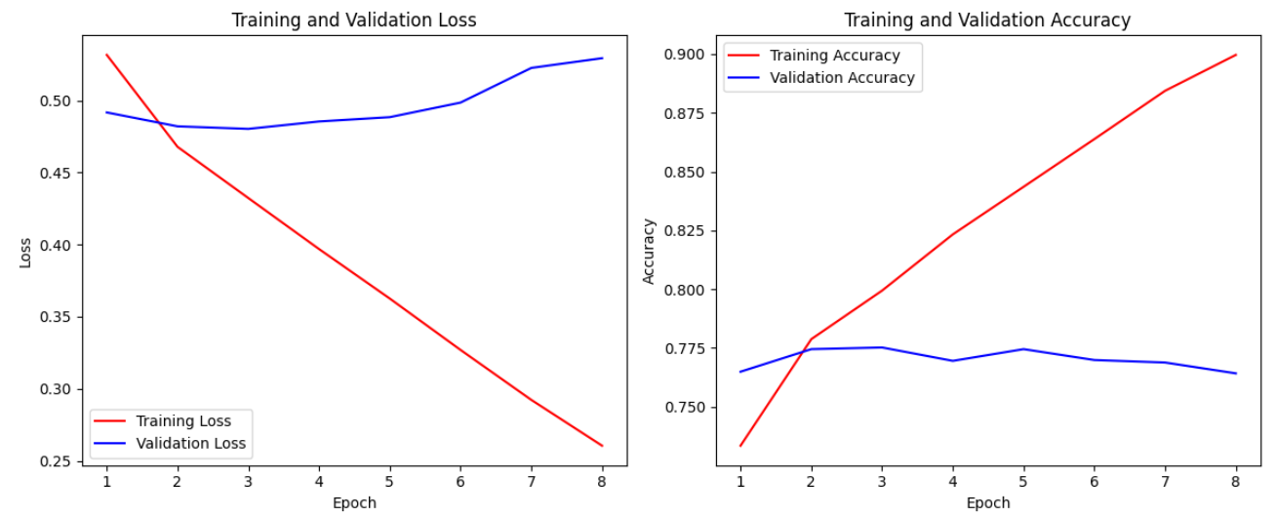
Last Approach: Binary Classification
Resaults of training the model on Binary classification task using AffNetBinary:

Slide 32
Future Suggestions
Emotion detection is a difficult task, applying blurring to a light weight model may not be ass effective as desired. One solution can be transfering the detection nearest to the edge device. Using MobileNet and fine-tuning it as well as quantisizing can be an asset instead of blurring.
For further approaches applying blurring method to binary classes can be interesting since the base model was performing relatively well.
Also it is also noticeable to add attention mechanism within different parts of the image [ViT] or we may also apply attention mechanisms within different frames [ViViT].

Slide 33
Questions
Iñigo Aduna Alonso
Minoo Safaeikouchaksaraei
Ahmad BeigRezaei
Notes:
Ahmad: With an expertise in MBA and Power Engineering.

Slide 34
Comparison to the state-of-art benchmarks
DDAMFN
Most of the starte-of-art models use the back bones of VGG16. But for other approaches the complexity increases by addition of multiple networks and modalities.
The DDA model is not easily imported as it is not defined in Pytorch framework but VGG16 can be imported easily.

Slide 35
Business Understanding
“AI systems … for the purpose of …detection of human emotions shall be classified as high-risk and subject to strict requirements to ensure transparency and the protection of fundamental rights”​ (AI Act, European Parliament, 2024)
PRIVACY & SECURITY
Notes:
Hidden Slide

